Slide 1
Natural Gas Demand & Supply Scenerio in India

Slide 2
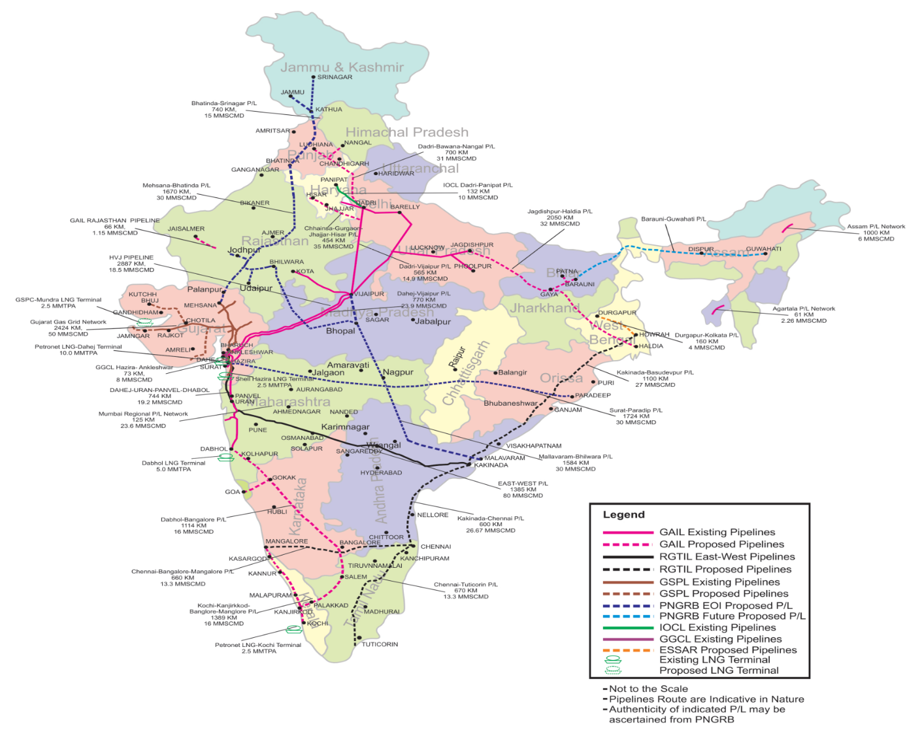
Natural Gas Pipeline Map
of India

Slide 3
Key Facts – Natural Gas Sector in India
Today about 6% share in primary energy mix; government targets to increase it to 15% by 2030
50-50% share of LNG and domestic gas in overall consumption in 2017-18
Existing pipeline connectivity of over 16,000 km; plans to increase to over 30,000 km
50% of current consumption from prime consuming sectors Power and Fertilizer, declining or stagnating
CGD and industrial use growing sectors and likely to emerge as key drivers.
Several new LNG capacity addition being planned; from current capacity of ~31.0 MTPA to 78 MTPA in 2021-22

Slide 4
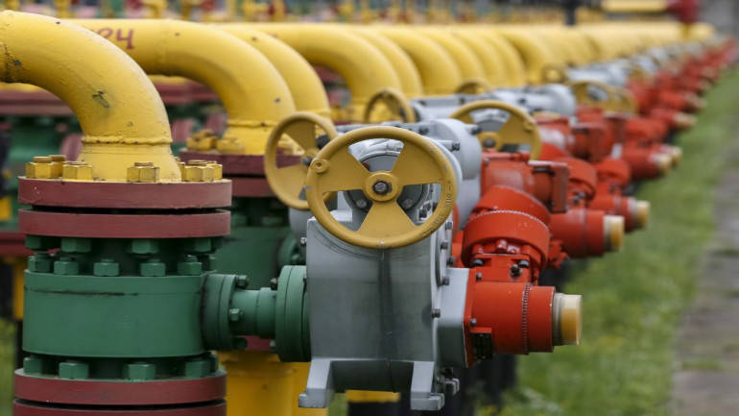
Increasing Infrastructure to Support the 15% Vision
Pipeline length/capacity ~17000 km/ 374 MMSCMD
Additional 15000 km pipeline coming up
Sufficient to handle about three times current consumption

Slide 5
Gas Demand

Slide 6
Consolidated Demand
Source: Gas demand estimates – NGS & others

Slide 7
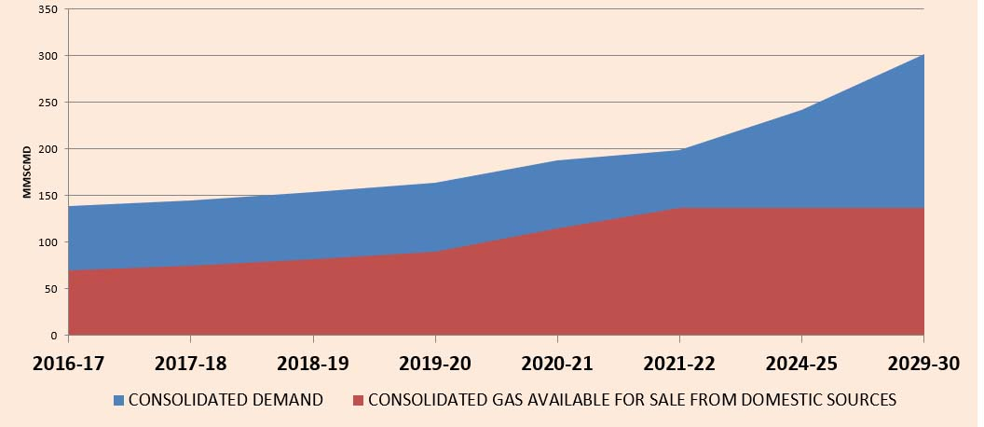
Gas Demand Supply Balance
MMSCMD | 2016-17 | 2017-18 | 2018-19 | 2019-20 | 2020-21 | 2021-22 | 2024-25 | 2029-30
CONSOLIDATED DEMAND | 139.11 | 144.87 | 153.74 | 163.41 | 187.28 | 198.77 | 241.82 | 301.59
CONSOLIDATED GAS AVAILABLE FOR SALE FROM DOMESTIC SOURCES | 69.92 | 74.44 | 81.61 | 89.8 | 114.5 | 136.9 | 136.9 | 136.9
BALANCE | 69.19 | 70.43 | 71.95 | 73.17 | 71.99 | 60.71 | 102.5 | 158.37

Slide 8
LNG Driving Consumption; Pricing Holds the Key
LNG imports rising 50% of consumption
LNG Regas capacity current 31 MMTPA
to increase to 60-70 MMTPA
Most additionally capacity planned along East Coast
LNG Capacity (MMTPA)

Slide 9
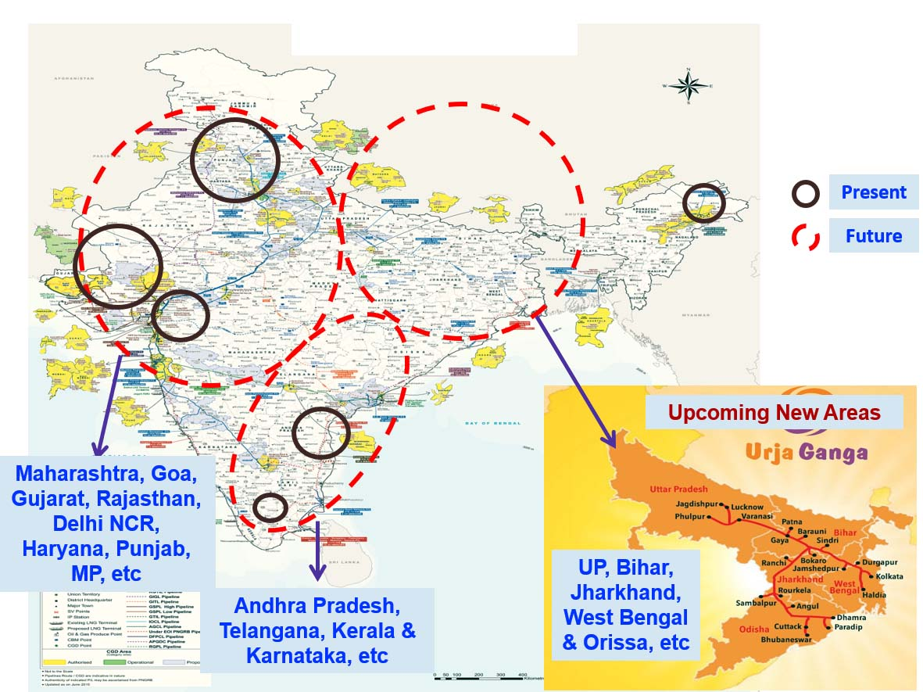
City Gas Distribution Network

Slide 10
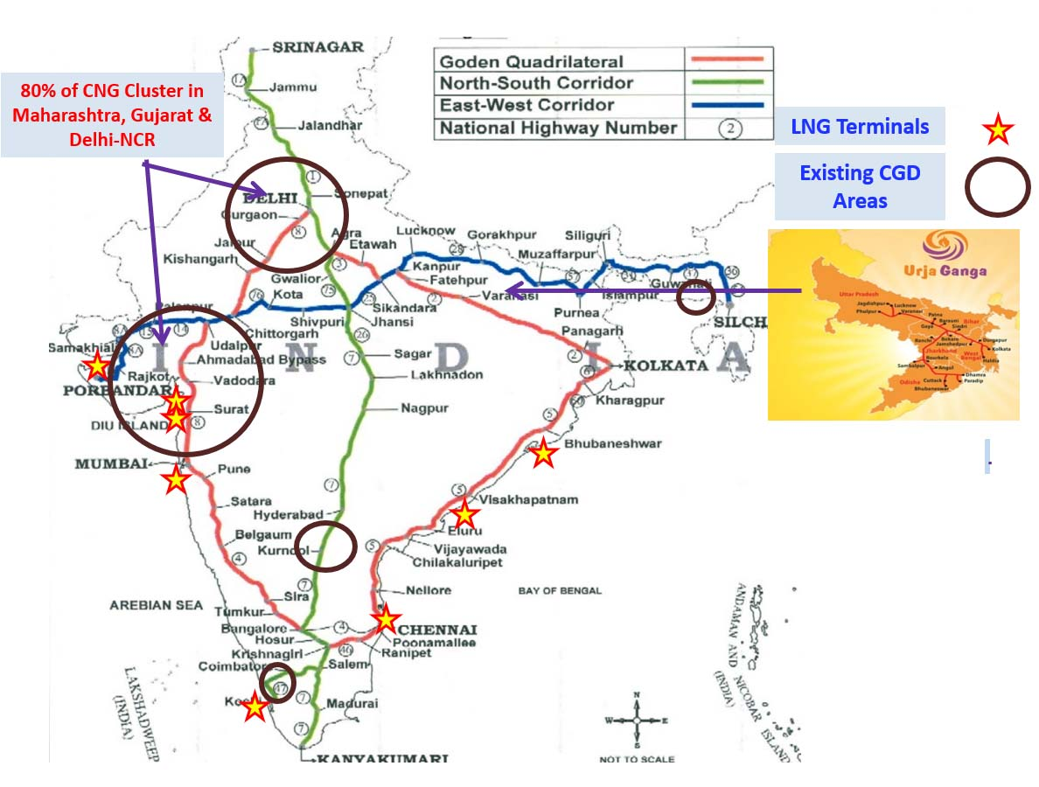
Developing The CNG Infrastructure

Slide 11
Growth of CGD by 2027
Key numbers | Before 9th round | After 9th round | After 10th round
No. of Gas | 92 | 178 | 228
No. of districts states covered | 124 | 280 | 402
No. of states/UTs covered | 23 | 26 | 27
Population covered | 20% | 50% | 70%
Geographical area covered | 11% | 35% | 53%
No. of CNG stations | 1477 | 5823 | 9401)
No. of CNG vehicles (million) | 3.18 | - | -
No. of PNG connections (million) | 4.68 | 25.68 | 45.68

Slide 12
Thank You

