Slide 1
A new Voice for India’s
Natural Gas Industry

Slide 2
^{The Genesis}
Rapidly expanding CGD sector
Evolving sectoral structure
Lack of long-term policy and vision, in the initial stages
No industry body to look at common issues, regulatory, policy etc.
Concern over high LNG Prices

Slide 3
^{Objectives}
Represent interest of its Members at various forums
Provide critical inputs to Policy Makers
Facilitate sharing of information and technology at national and international level
Promote investments in natural gas sector

Slide 4
^{The Organisation}
Natural Gas Society
LNG Forum
CGD Forum
Knowledge Research
CNG Eco Connect

Slide 5
^{Current Membership}
GAIL (India) Limited
Petronet LNG Limited
Indraprastha Gas Limited
Mahanagar Gas Limited
Green Gas Limited
Adani Gas Limited
Central UP Gas Limited
Maharashtra Natural Gas Limited
Siti Energy Limited
Bhagyanagar Gas Limited
Aavantika Gas Limited
Torrent Gas Pvt Ltd.
Sanwariya Gas Limited

Slide 6
^{NGS Activities}
Policy input on natural gas
As a member of International Gas Union and Asian Gas Market Forum (China)
Nodal agency to represent india at the research project of Asian Gas Forum
Policy action inputs to administrative/regulatory authorities

Slide 7
^{NGS Activities}
CGD Forum
Platform for all stakeholders for exchange of issues and collaboration in areas like Safety, Standards etc.
Membership of Forum is open to all CGD companies/associated entities
Creation of special task force for specific issues

Slide 8
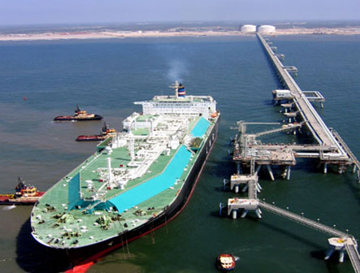
^{NGS Activities}
Knowledge & Research
News and information on natural gas, LNG and NGV, CNG sector
Databanks for gas statistics
Specific studies on gas demand and supply
Track developments and issues pertaining to CGD sector

Slide 9
^{Outreach}
Acceptability –
Industry, Forums, Regulator, MoPNG, BIS, PESO
Linkages with……….
PNGRB
Only Indian Gas Body to have representation in………..
AGF
Asian Gas Forum
US – India Gas Task Force

Slide 10
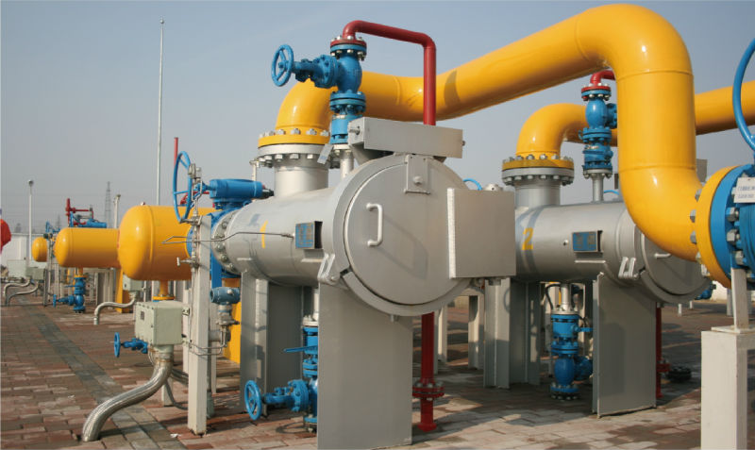
^{Why Support NGS?}
Collective access to authorities
Government, agencies, regulators prefer coordinated voice
Provide cost-effective, collective services to businesses
Undertake specific projects which may benefit members or the industry as a whole.

Slide 11
^{NGS – Proposed Activities}
Gas
Advocacy
Application
Development
Discussion papers on various issues pertaining to the CGD industry
Marine-CNG/LNG waterways, ferries, barges houseboats, fishing boats, etc.

Slide 12
^{NGS Proposed Activities}
Award
Academic Programmes
Management Development Programmes for CGD Companies
Economic & Technical Research
Sector Tracking

Slide 13
^{To Know More}
Please visit our website and follow us on Facebook & Twitter pages.
www.ngsindia.org
https://www.facebook.com/NaturalGasSociety/
https://twitter.com/FollowNGS
naturalgasindia.ngs@gmail.com
0120-4220882,4222849

