Slide 1

CNG DISPENSER
User Experience & Expectations
Delineated by: Y.S Navathe & Team CNG
Adani Gas Ltd.
NGS Summit
15th – 16th December’ 2017

Slide 2
A Dispenser To A SMART Dispenser
Customer
Customized
Design
Automation
Conventional Dispenser
Pressure
Accuracy
Statutory Compliance
User
Perspective
Smart Dispenser
Accuracy
POS Facilitations
Ease of doing business
Raw CNG Perspective
Value Added Perspective
Filler/Operator
CGD Entity
Standardisation

Slide 3
User Experience And Expectations From CNG Dispensers
CNG Dispenser:
A CNG dispenser is a machine at a CNG filling station that is used to refuel CNG into vehicles.
Smart CNG dispenser:
A smart CNG dispenser will be a machine that shall apply concepts of advance automation and will maximize its efficiency, support remote monitoring and emergency control resulting in complete customer satisfaction and responsive to User Perspectives.

Slide 4
Need Of The Hour: SMART DISPENSER
SCADA Enabled: All the real time parameters of dispenser shall be monitored/controlled through SCADA. It should be capable for transferring data over a standard protocol(Ethernet).
Customized Flexible Design: Make minimum proprietary hardware/software and incorporation of essential safety features. Bought out items as per company requirements.
Standardization of Requirement: Dispenser design shall be as per user (customer/gasco/filler) needs/specifications.

Slide 5
Features Of Smart CNG Dispenser
Sr. No. | Features | Consumer | Filler/Operator | CGD Entity
1 | Accuracy
1.1 | Preset filling | ü | ü | ü
1.2 | Electronic valve |  |  | ü
1.3 | Digital Pressure indicator | ü | ü | ü
1.4 | Repeatability |  |  | ü
2 | POS functionalities
2.1 | Bill Generation | ü | ü | ü
2.2 | Card swiping feasibility | ü
2.3 | Local data storage |  |  | ü
2.4 | Time based rate change | ü |  | ü
2.5 | Online billing through SCADA |  |  | ü
2.6 | Customized design |  |  | ü

Slide 6
Sr. No. | Features | Consumer | Filler/Operator | CGD Entity
3 | Ease of doing business
3.1 | Preset filling | ü | ü | ü
3.2 | Cylinder Hydro testing | ü | ü | ü
3.3 | PLC based operation |  |  | ü
3.4 | Electronic Actuation Valve |  |  | ü
3.5 | Digital Pressure indicator | ü | ü | ü
3.6 | Double hand operation of nozzle |  | ü
3.7 | Compact design |  |  | ü
3.8 | Safety interlocks | ü | ü | ü
3.9 | Recipe module |  |  | ü
3.10 | Four way dispensing | ü |  | ü
3.11 | LED display | ü | ü | ü
3.12 | Customized design |  |  | ü
3.13 | Visual indication through beacon lamps | ü |  | ü
3.14 | Filler Identification |  | ü | ü
3.15 | Identification of Malpractices |  |  | ü

Slide 7
What Each Feature Means ?
Sr. No. | Feature | Proposed Ameliorations
1 | Preset filling | Dispenser Software program shall be modified to enable Preset filling both in Kg. and Rs.
2 | Cylinder Hydro testing | Incorporation of bar code/RFID scanner on dispenser body to verify cylinder test life and validate it for refueling.
3 | PLC based operation | Single PLC can be used to operate 16 arms. Microcontrollers (MCU)are used for smaller applications(32 I/Os) whereas a PLC is capable of supporting more than 100 I/Os . PLCs are rugged compared to MCU. PLCs can be placed away from gas zone.
4 | Bill Generation | Inherent Printer on dispenser.
5 | Card swiping facility | POS to be integral part of dispenser to facilitate payment through card.
6 | Electronic valve | To eliminate use of compressed air/gas, electronic control valves can be used.
7 | Digital Pressure Indicator | It can be used instead of conventional gauges.

Slide 8
What Each Feature Means ?
Sr. No. | Feature | Proposed Ameliorations
8 | Ease in handling of nozzle | Use of NGV nozzle instead of NZS, this will also eliminate the gas loss during O-ring failure.
9 | Identification of malpractice | In case of theft from dispenser, it should stop filling and generate an error message.
10 | Size of dispenser | With the elimination of hardware its design can be made compact . Four way dispensers can be installed.
11 | Local data storage | In case of unavailability of data at Master control room(Communication failure), PLC will be equipped with local storage facility. Conventional dispenser can store data up to 4 KB for 2 months whereas SMART dispenser can store data up to 4GB for 6 months.
12 | Safety interlocks | Excess gas flow cut-off Proximity sensors that can cut-off power supply during maintenance.
13 | Auto selection of Car/bus mode | Recipe module can be used to aid auto selection.
14 | Display | LED/LCD display shall be used for improved visibility.
15 | Customized design | Dispenser components should be as per user specification rather than specified by OEM.

Slide 9
What Each Feature Means ?
Sr. No. | Features | Proposed Ameliorations
16 | Identification of Spare nozzle | Visual indication through beacon lamps at entry of station.
17 | Filler Identification | Dispenser should be able to read the identification code provided to filler.
18 | Accuracy and repeatability | Mass flow meter(MFM) used should be as per application i.e. selection of MFM as per flow requirement (Bus/Car/Two Wheeler)
19 | Special features | Through PLC multiple features can be utilized: Number of fillings from particular arm. Rapid rate change can be done. In case of anomaly dispenser will generate alarm and restrict to start the filling.
20 | High speed data communication | With the use of PLC data from field devices shall be retrieved at speed of 100 Mbps instead of 9600/38400 bps. Mass flow meter shall provide data on standard baud rate of 38400 bps
21 | Billing through SCADA | Through high speed communication and data reliability the data obtained from dispensers can be used for centralized billing through SCADA.

Slide 10
Integration of SCADA : AGL Experience
Protocol synchronization:
Identifying communication protocol supported by Motherboard of dispenser (Modbus RS 485)
Identifying communication protocol supported by Programmable logic control (Ethernet)
To transfer the data from Dispenser to PLC a serial server is used that converts dispenser data from Modbus to Ethernet (read & write facilities enabled).
Communication platform:
Data is transferred from CNG station to Master Control Room through VSAT (primary) and GPRS (redundant) communication system.
SCADA Database Configuration:
Raw data obtained from all PLCs is read by server that facilitates graphics building, alarm configuration, monitor, gather and process real time data.
SCADA platform is used for revenue linkage (data transfer from SCADA to SAP for online billing).

Slide 11
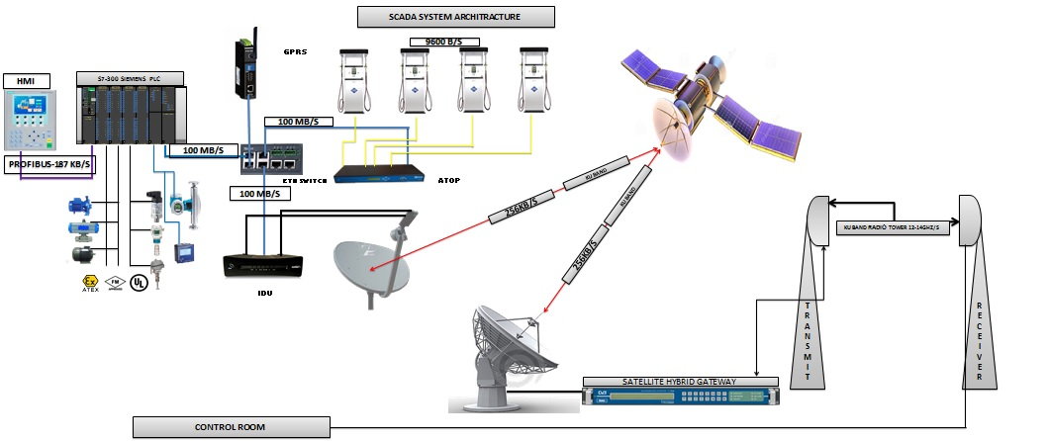
SCADA Architecture:

Slide 12
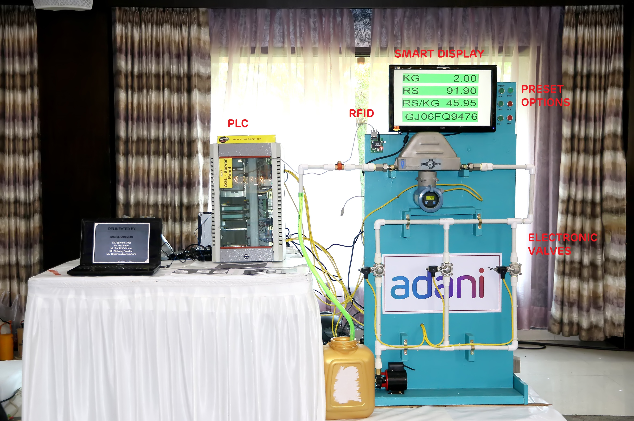
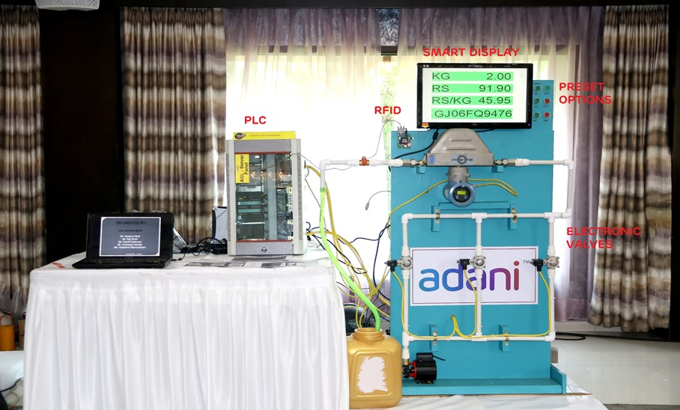
Glimpse Of Smart CNG Dispenser

Slide 13
Working Of SMART Dispenser:
In the working model of smart dispenser we had circulated water instead of gas.
This dispenser was controlled through PLC (Simatic S7 300) and Preset filling options were programmed in it.
Bar code scanner was placed on dispenser body and data of vehicle was already stored in PLC.
When the vehicle arrives for refueling it is first checked by bar code scanner, if found under test life a message appears on display “Ready for filling” else the system will not take start command.
Preset Quantity was entered by filler and same was verified at outlet through measuring vessel.
All the ON/OFF valves used were electronic.

Slide 14
BLOCK DIAGARM
DISPENSER MODEL
SCADA
SOLENOID VALVE MECHANISM
LP-MP-HP-DELIVERY
PLC
PRESET OPTION
START PB
MASS FLOW METER
RFID/BAR CODE
PRESET QUANTITY TO OUTLET
VEHICLE TO BE FILLED

Slide 15
Perusal of Cost
Description | Smart CNG Dispenser | Conventional CNG Dispenser
Unit Cost | Overall 30 to 40% cost can be saved
Cost of SCADA Connectivity | Max. Up to 2 lakhs For entire station | 3 Lakhs for entire station
Power Consumption | Minimum | Maximum
Operational Cost | Minimum | Maximum
Operational Loss | Minimum | Maximum
Operational Safety | High | Minimum
Maintenance Cost | Minimum | Maximum
Equipment Breakdown | Minimum | Frequent
Equipment Efficiency | High | Low
Space requirement | Low | High

Slide 16


